Slide 1
GO Team Meeting #1
Scott Elementary
October 1, 2025

Slide 2
Agenda
Call to Order
Roll Call; Establish Quorum
Action Items
Approval of Agenda
Approval of Previous Minutes:
Discussion Items
School Strategic Plan
Strategic Plan & Priorities Review
SMART Goals
Data Discussion
MAP Results
2025 GA Milestones Results
Information Items
Principal’s Report
Additional Information Items
APS Forward 2040 –Comprehensive Long-Range Facilities Plan Update
Announcement

Slide 3
2021-2025 Strategic Plan

Slide 4
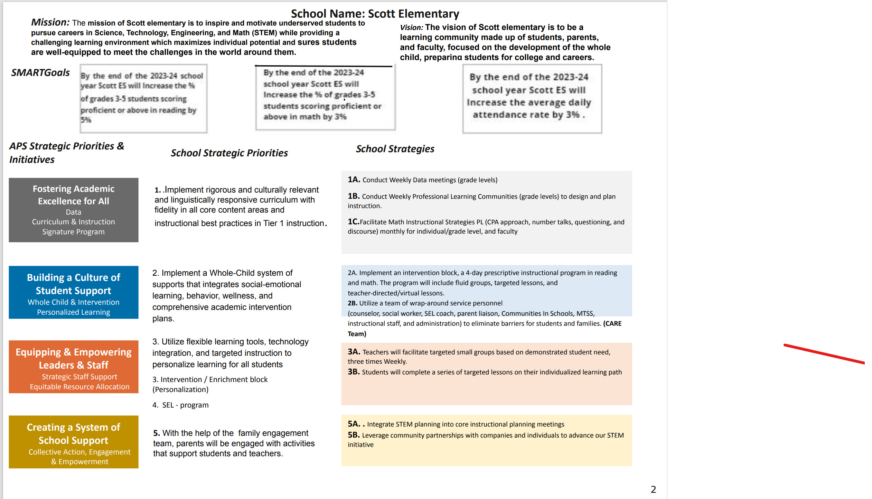
Literacy: Increase the % of grades 3-5 students scoring proficient or above in English Language Arts on the Georgia Milestones Assessment from 13% in Spring2024 to 18% or higher in Spring 2025.
Numeracy :Increase the % of grades 3-5 students scoring proficient or above in Mathematics on the Georgia Milestones Assessment from approximately 21% in Spring 2024 to 25% or greater in Spring 2025.
Whole Child & Intervention: Increase our CCRPI attendance of students not chronically absent from 71.3% for SY24-25 to 74.3% or higher for SY24-25.

Slide 5
Strategic Plan
Priority Ranking
Insert the school’s priorities from Higher to Lower
Higher
Implement rigorous and culturally relevant and linguistically responsive curriculum with fidelity in all core content areas and instructional best practices in Tier 1 instruction.
Implement a Whole-Child system of supports that integrates social-emotional learning, behavior, wellness, and comprehensive academic intervention plans.
Utilize flexible learning tools, technology integration, and targeted instruction to personalize learning for all students.
SEL - program
With the help of the family engagement team, parents will be engaged with activities that support students and teachers.
Lower

Slide 6
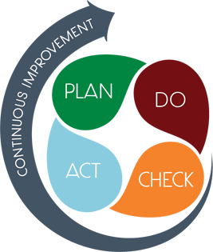
Connecting the Strategic plan & Continuous Improvement Plan
Strategic Plan Priority
CIP SMART Goal
Implement rigorous and culturally relevant and linguistically responsive curriculum with fidelity in all core content areas and instructional best practices in Tier 1 instruction.
By the end of the 2025-2026 school year, the 3rd-5th grade students will increase those scoring developing or above by 5% from SY24-25 (23%) to SY25-26 (28%) on the spring 2026 EOG in ELA .
Utilize flexible learning tools, technology integration, and targeted instruction to personalize learning for all students.
By the end of the 2025-2026 school year, the 3rd-5th grade students will increase those scoring developing or above by 5% from SY24-25 (26%) to SY25-26 (31%) on the spring 2026 EOG in Mathematics
Implement a Whole-Child system of supports that integrates social-emotional learning, behavior, wellness, and comprehensive academic intervention plans.
Increase our CCRPI attendance of students not chronically absent from 74.7% for SY24-25 to 77.7% or higher for SY25-26.

Slide 7
Data Discussion

Slide 8
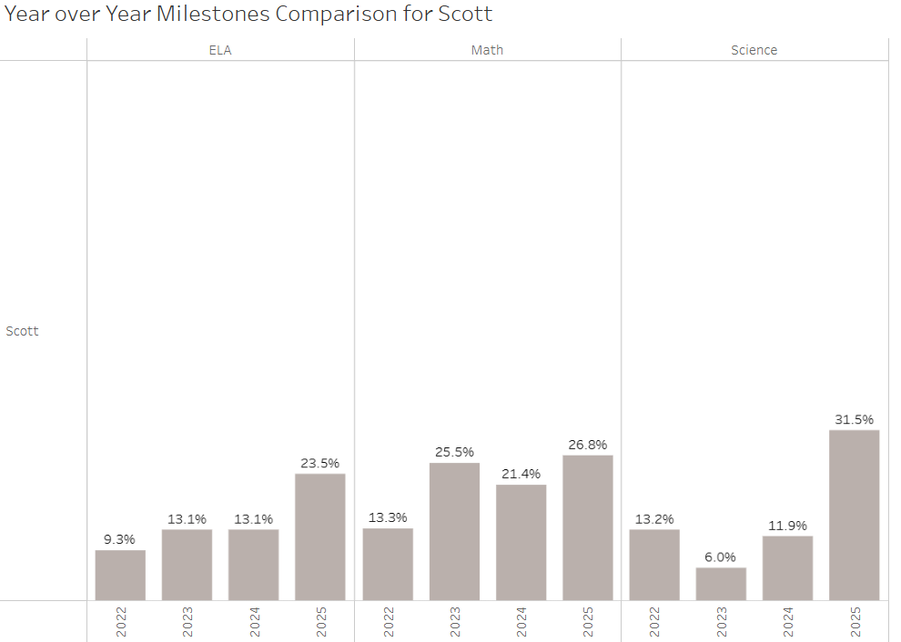
GMAS Results: Spring 2025

Slide 9
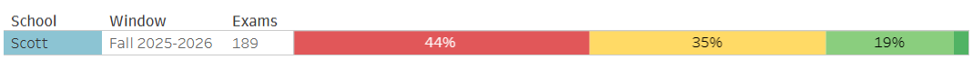
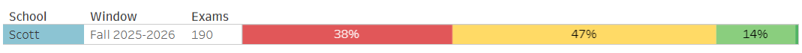
MAP Results: Fall 2025
ELA
Math

Slide 10
Measures
Weekly CFA
Unit Assessments
Checkpoints
Weekly Attendance Data
are we on target to successfully ACCOMPLISH our priorities?
IMPACT

Slide 11
GO Team Discussion: Data Protocol
What do you notice?
What are your wonderings?
Based on our school’s trend data from MAP assessments and end-of-year test assessments, which student sub-groups and grade levels showed the most significant gaps or unexpected trends?
Based on our school’s trend data from MAP assessments, Milestones and other indicators, are there specific trends that require more focused attention?
What additional questions do you have?

Slide 12
Timeline for GO Teams
You are HERE
Fall 2021
GO Team Developed 2021-2025 Strategic Plan
1
Summer
School Leadership completed Needs Assessment and defined overarching needs
2
August
School Leadership completed Continuous Improvement Plan
3
Sept. – Dec.
GO Team reviews progress on current strategic plan.
GO Team develops 2025-2030 School Strategic Plan
4
Before Winter Break
GO Team will take action (vote) on the rank of the strategic plan priorities for SY26-27 in preparation for budget discussions.
5

Slide 13
Questions?

Slide 14



Please do this exercise ONLY if not discussed by the GO Team at a previous meeting
Why We’re Here
GO Teams play a vital role in decision-making that impacts the school’s direction, priorities, and overall success.
Stakeholder engagement ensures that the decisions we make reflect the real needs and voices of the people our schools serve.
We’re stronger when we bring others into the work—when we listen, learn, and co-create with families, students, staff, and community members.
Today our GO Team will: Brainstorm ways to involve our school’s key stakeholders in our work.
Stakeholder
Engagement
At Our School
Notes:
Next, we’re going to discuss stakeholder engagement. As a charter system, the decisions the GO Team makes shapes our school’s future — and the best decisions come from hearing the diverse voices within our school community..
When we bring families, students, staff, and our community into the work—not just into the audience—we get stronger ideas, better outcomes, and a shared vision we can all stand behind.

Slide 15
Please do this exercise ONLY if not discussed by the GO Team at a previous meeting
Here’s the challenge:
We’re going to look at four groups—Families, Students, Staff, and Community.
For each group, we’ll ask and answer three questions:
INFORM – What’s a fun or unexpected way to keep them in the loop?
INPUT – What’s a meaningful way to get their ideas or feedback?
INVITE – How can we bring them into the work, not just the audience?
Let’s get creative, specific, and push past the usual answers.
Stakeholder
Engagement
Exercise
Notes:
Here’s the challenge: We’re going to look at four groups—Families, Students, Staff, and Community.
For each one, we’ll answer three questions:
INFORM – What’s a fun or unexpected way to keep them in the loop? INPUT – What’s a meaningful way to get their ideas or feedback? INVITE – How can we bring them into the work, not just the audience?
Let’s get creative, get specific, and push past the usual answers.

Slide 16

 | FAMILIES | STUDENTS | STAFF | COMMUNITY
INFORM What’s a fun, unexpected way to keep them in the loop?
INPUT What’s a meaningful way to gather their ideas or feedback?
INVITE How can we bring them into the work, not just the audience?
Notes:
Here’s the challenge: We’re going to look at four groups—Families, Students, Staff, and Community.
For each one, we’ll answer three questions:
INFORM – What’s a fun or unexpected way to keep them in the loop? INPUT – What’s a meaningful way to get their ideas or feedback? INVITE – How can we bring them into the work, not just the audience?
Let’s get creative, get specific, and push past the usual answers

Slide 17
Principal’s Report

Slide 18

Please do ONLY if not presented to the GO Team at a previous meeting
(SCHOOL NAME)
LEVELING AND
FY26 BUDGET ADJUSTMENT
Template Last Revised: 9/4/2025

Slide 19

Enrollment
Projected Enrollment
15-Day Count(08.22.25) Enrollment
Difference
Budget Adjustment* | $XX,XXX (Principal: input change in allocation for your school)
*The budget adjustment reflects the impact of the following: Enrollment changes, school reserves, Title I Part A, Title I- Family Engagement
Hold harmless
To support academic stability in schools, budgets were not reduced beyond school reserves.
Notes:
Principals: Based on your15-Day count, please give your GO Team an overview of your projected vs. 8/22 enrolled numbers as well as information on your FY26 budget adjustment.

Slide 20
Plan for FY26 Leveling Reserve
$___(Insert Amount Here)___
Priorities | Strategies | Requests | Amount
Increase level of rigor and relevance (example- please remove) | Implementation of guided reading training for all staff (example- please remove) | Purchase an additional Teacher (example- please remove) | $84, 134 (example- please remove)
EXAMPLE
Before Presenting to your GO Team:
Insert the Plan for the
FY26 Leveling Reserve Slide from your
Feb 2025 Budget Presentation; If you don't have access to the file from Feb. 2025—complete the slide and share it with your team.
Notes:
Review the previously discussed plan for the FY26 Leveling Reserve as discussed by the GO Team in your Feb. 2025 Budget Feedback meeting and March 2025 Approval meeting.

Slide 21
Plan for FY26 Title I Holdback
$___(Insert Amount Here)___
Priorities | Strategies | Requests | Amount
Increase level of rigor and relevance (example- please remove) | Implementation of guided reading training for all staff (example- please remove) | Purchase an additional Teacher (example- please remove) | $84, 134 (example- please remove)
EXAMPLE
Before Presenting to your GO Team:
Insert the Plan for FY26 Title I Holdback slide from your Feb 2025 Budget Presentation for reference (if applicable). If you don't have access to the file from Feb. 2025—complete the slide and share it with your team.
Notes:
Review the previously discussed plan for the FY26 Title I Holdback as discussed by the GO Team in your Feb. 2025 Budget Feedback meeting and March 2025 Approval meeting.

Slide 22
Summary of Changes as a Result of FY26 Budget Adjustment
Personnel Changes | Non-Personnel Changes
Summary of Changes
PRINCIPALS: Please provide a summary of the impact these changes and how it relates to your strategic plan here.

Slide 23
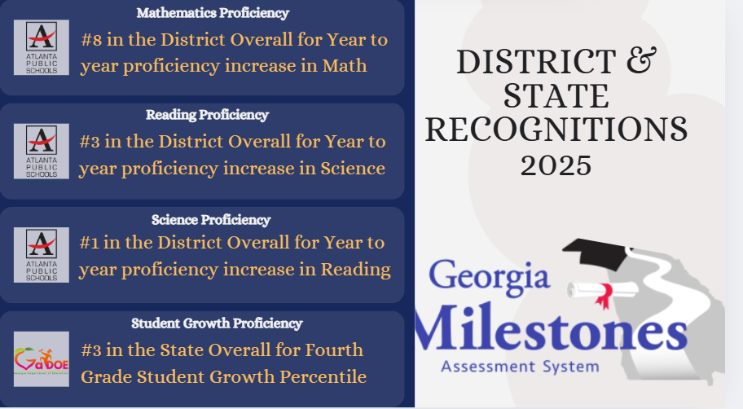

Slide 24


APS Forward 2040:
Reshaping the Future of Education
Taskforce Meetings
May 8, 2025 - Presentation
August 5, 2025- Presentation
Upcoming Public Meetings
October 20
November 10
Virtual – at Noon
In-person at 6PM at CLL (130 Trinity Ave)
UPDATE
Comprehensive Long-Range Facilities Plan
atlantapublicschools.us/APS2040
Notes:
Next on our agenda, we’d like to welcome our representative to the Long-Range Comprehensive Facilities Master Plan Taskforce. As many of you know, this taskforce plays a key role in shaping the future of our district’s facilities — ensuring they are aligned with projected enrollment, instructional needs, safety standards, and long-term community use."
Over the summer, the taskforce has been hard at work reviewing data, exploring options, and engaging in important planning conversations. [Name of Representative] will share an update on what’s been done so far, any key decisions or recommendations that have been made, and what’s ahead — including opportunities for the public to provide input.
[Allow the FMP representative to provide an update and answers questions. After this is concluded:]
Thank you [Name of Representative].
A report will be presented to the Board at its August 11 meeting, and the options will become public the week of August 18.
There are several upcoming public meetings where you can learn more and share your thoughts. The next public meetings are scheduled for: August 25, October 20, and November 10
On each date, there will be a virtual meeting at noon and an in-person meeting at the Central Office at 6PM.
I strongly encourage you all to attend these meetings. This is a critical time for public input, and your voice is essential.

Slide 25
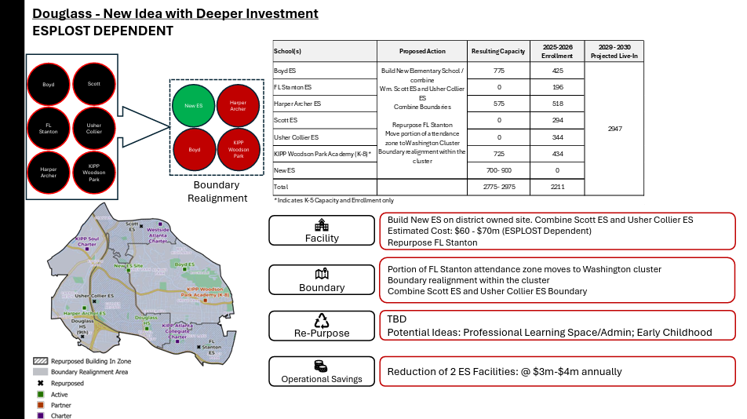

Slide 26
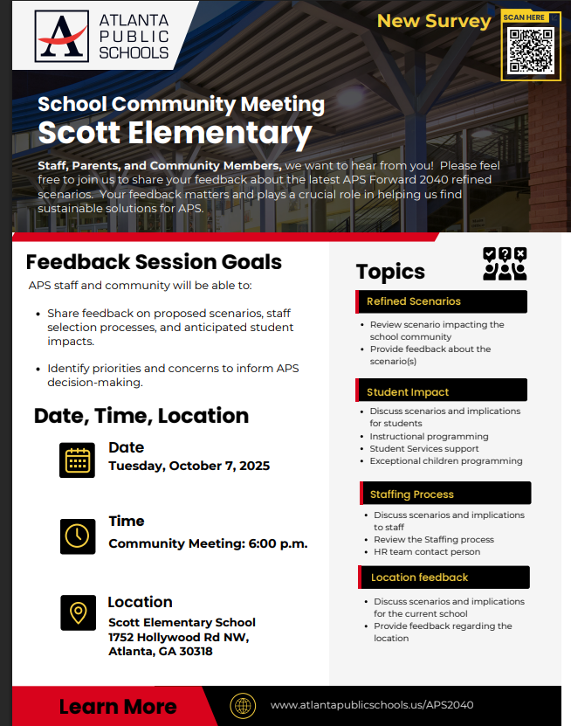

Slide 27
Upcoming Events
Custodian Appreciation Day October 2nd
Pink Out Friday October 3rd
Community Meeting- October 7th Scott’s Gym
Hispanic Heritage Spirit Week October 6-10
Hispanic Heritage and Ram Recognition Program October 10 @ 1:00 pm
Fall Break October 13-17
Pink Out Friday October 24th
Red Ribbon Week October 27-31

Slide 28
SAVE THE DATE
IN-PERSON
G3 Summit
Go.Grow.Govern.
Bring the full GO Team
Come ready to collaborate, contribute, and create the future!
Saturday
September 27
8:30 AM – 2:30 PM
Come learn more about:
Your school’s 2025-2030 Strategic Plan
Stakeholder Engagement
Charter System
…and much more
Atlanta College & Career Academy
1090 Windsor St SW
Notes:
Before we move on, I want to highlight an important upcoming event: the G3 Summit on Saturday, September 27 at the Atlanta College and Career Academy.
We need as many GO Team members as possible to attend — this is a critical opportunity to come together, in person, and shape the future of our schools. Strategic planning for 2025–2030 is underway, and your voices, ideas, and leadership are essential.
You’ll be learning about your school’s new strategic plan, best practices for stakeholder engagement, and how this work connects to APS Forward 2040 — plus much more.
Please save the date and plan to attend! Come ready to collaborate, contribute, and create the future together.
More information will be coming soon.

Slide 29
Questions?

